Slide 1
Member Portal

Slide 2
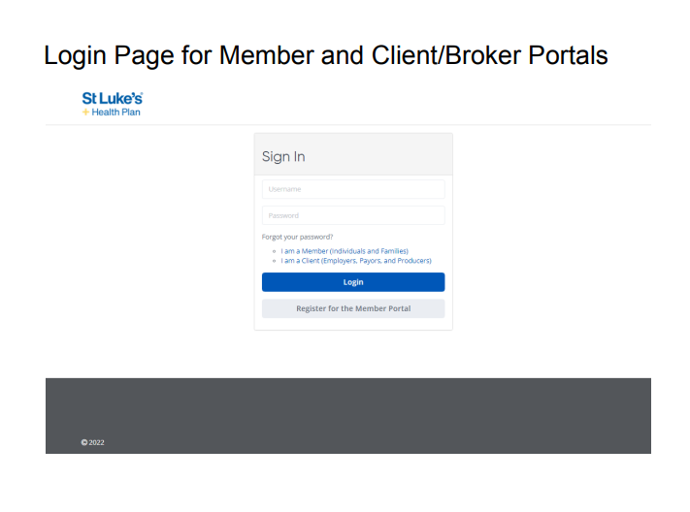
Login Page for Member Portal

Slide 3
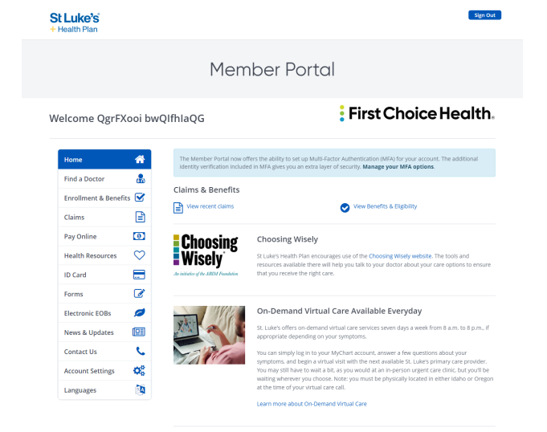
Member Portal: Homepage

Slide 4
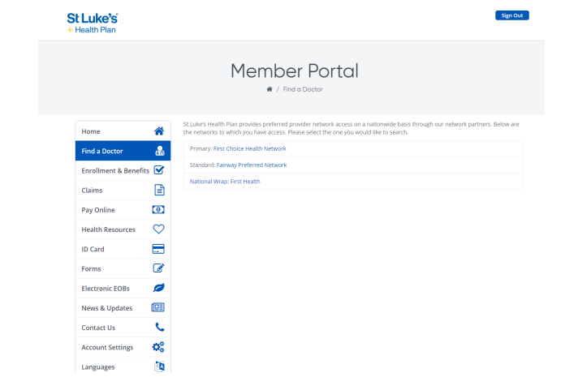
Member Portal: Find a Provider
Notes:
Talking Points:
Majority of opportunity is in group, particularly large group
This includes membership from other partners. What is our commitment to multi-payer strategy and supporting value-based efforts with the network?
Noting that the Large group self-insured has a large portion of membership from national payers (amazon, home depot, starbucks, Walmart, etc)

Slide 5
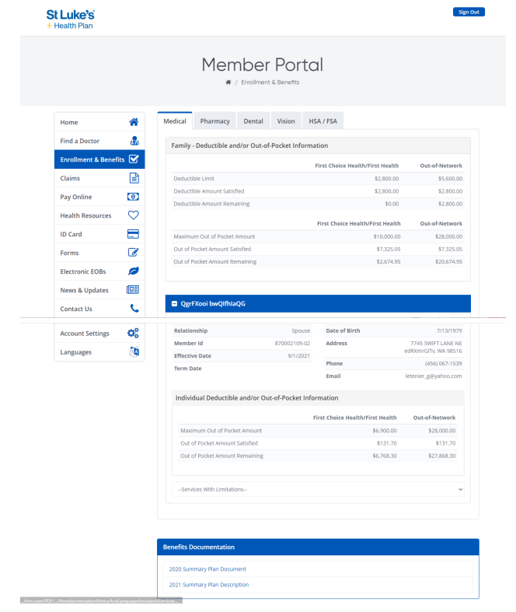
Member Portal: Enrollment and Benefits
Notes:
Talking Points:
Majority of opportunity is in group, particularly large group
This includes membership from other partners. What is our commitment to multi-payer strategy and supporting value-based efforts with the network?
Noting that the Large group self-insured has a large portion of membership from national payers (amazon, home depot, starbucks, Walmart, etc)

Slide 6
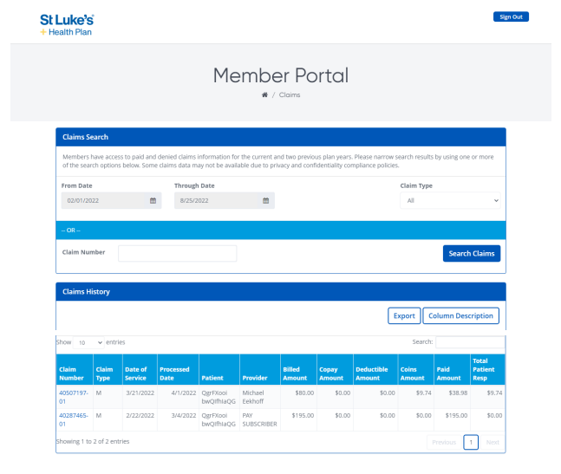
Member Portal: Claims
Notes:
Talking Points:
Majority of opportunity is in group, particularly large group
This includes membership from other partners. What is our commitment to multi-payer strategy and supporting value-based efforts with the network?
Noting that the Large group self-insured has a large portion of membership from national payers (amazon, home depot, starbucks, Walmart, etc)

Slide 7
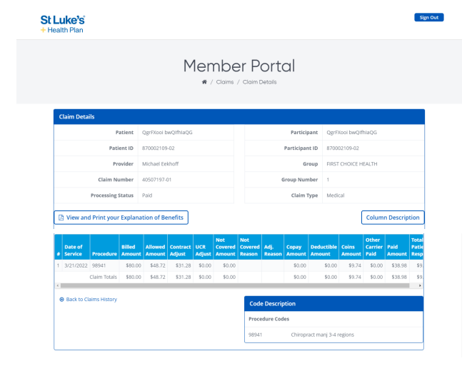
Member Portal: Claims Details
Notes:
Talking Points:
Majority of opportunity is in group, particularly large group
This includes membership from other partners. What is our commitment to multi-payer strategy and supporting value-based efforts with the network?
Noting that the Large group self-insured has a large portion of membership from national payers (amazon, home depot, starbucks, Walmart, etc)

Slide 8
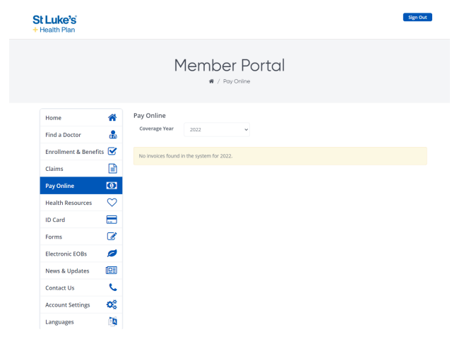
Member Portal: Payment
Notes:
Talking Points:
Majority of opportunity is in group, particularly large group
This includes membership from other partners. What is our commitment to multi-payer strategy and supporting value-based efforts with the network?
Noting that the Large group self-insured has a large portion of membership from national payers (amazon, home depot, starbucks, Walmart, etc)

Slide 9
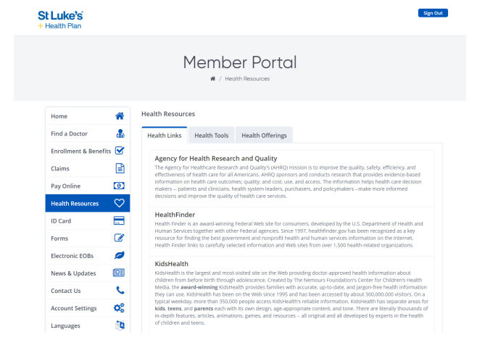
Member Portal: Health Resources
Notes:
Talking Points:
Majority of opportunity is in group, particularly large group
This includes membership from other partners. What is our commitment to multi-payer strategy and supporting value-based efforts with the network?
Noting that the Large group self-insured has a large portion of membership from national payers (amazon, home depot, starbucks, Walmart, etc)

Slide 10
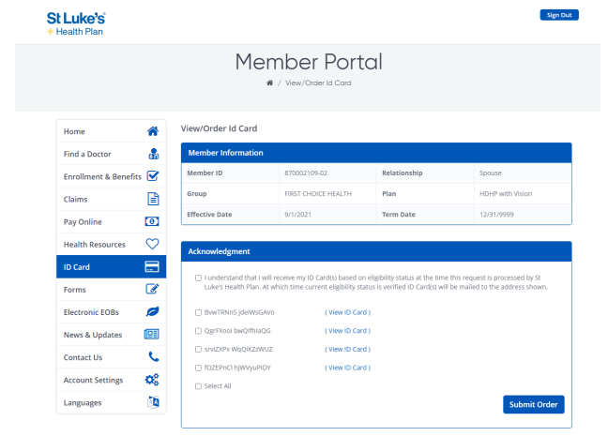
Member Portal: ID Card
Notes:
Talking Points:
Majority of opportunity is in group, particularly large group
This includes membership from other partners. What is our commitment to multi-payer strategy and supporting value-based efforts with the network?
Noting that the Large group self-insured has a large portion of membership from national payers (amazon, home depot, starbucks, Walmart, etc)

Slide 11
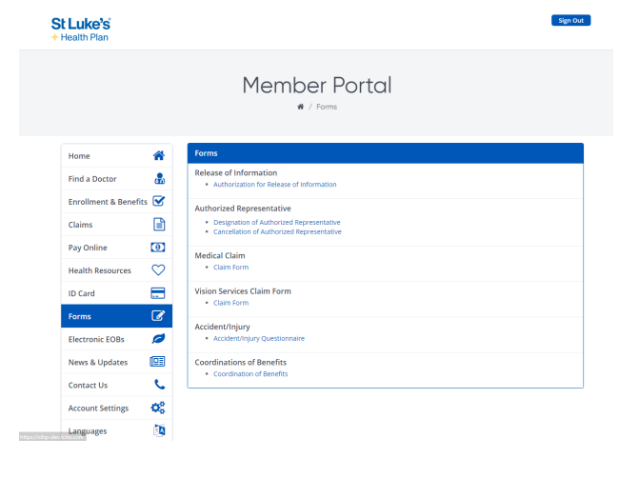
Member Portal: Forms
Notes:
Talking Points:
Majority of opportunity is in group, particularly large group
This includes membership from other partners. What is our commitment to multi-payer strategy and supporting value-based efforts with the network?
Noting that the Large group self-insured has a large portion of membership from national payers (amazon, home depot, starbucks, Walmart, etc)

Slide 12
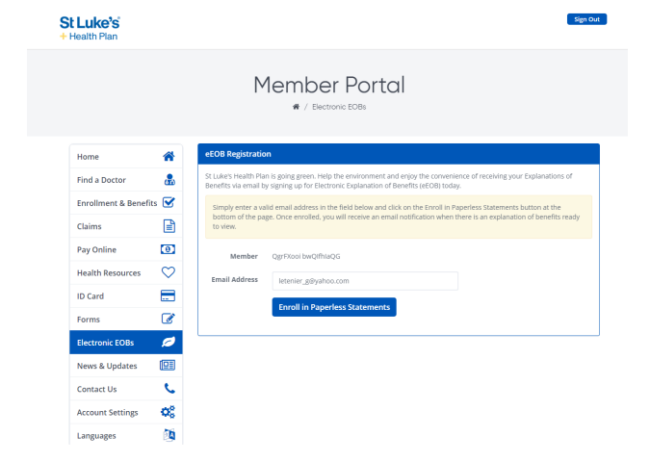
Member Portal: Explanation of Benefits (EOB)
Notes:
Talking Points:
Majority of opportunity is in group, particularly large group
This includes membership from other partners. What is our commitment to multi-payer strategy and supporting value-based efforts with the network?
Noting that the Large group self-insured has a large portion of membership from national payers (amazon, home depot, starbucks, Walmart, etc)

Slide 13
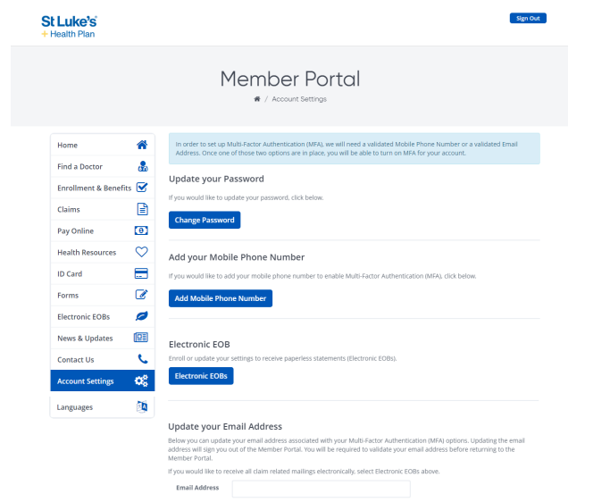
Member Portal: Account Settings

Slide 14

First Choice Health

