Slide 1

St. Luke’s Health Plan
CY2027 Medicare Advantage
Broker Sales Presentation

Slide 2
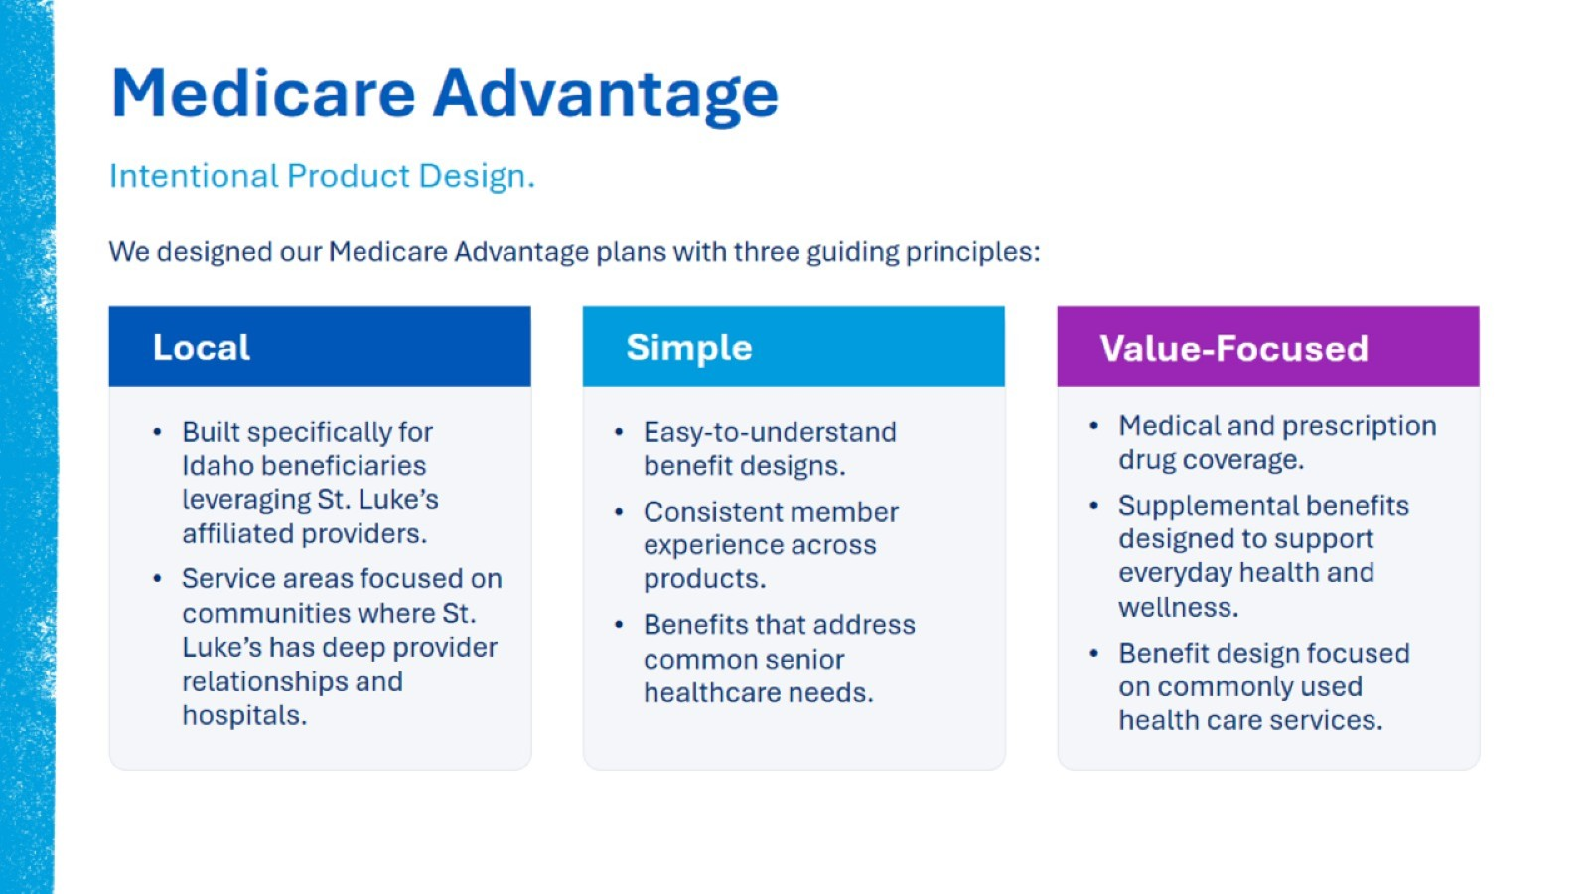
Medicare Advantage

Slide 3

St. Luke's Advantage Network

Slide 4
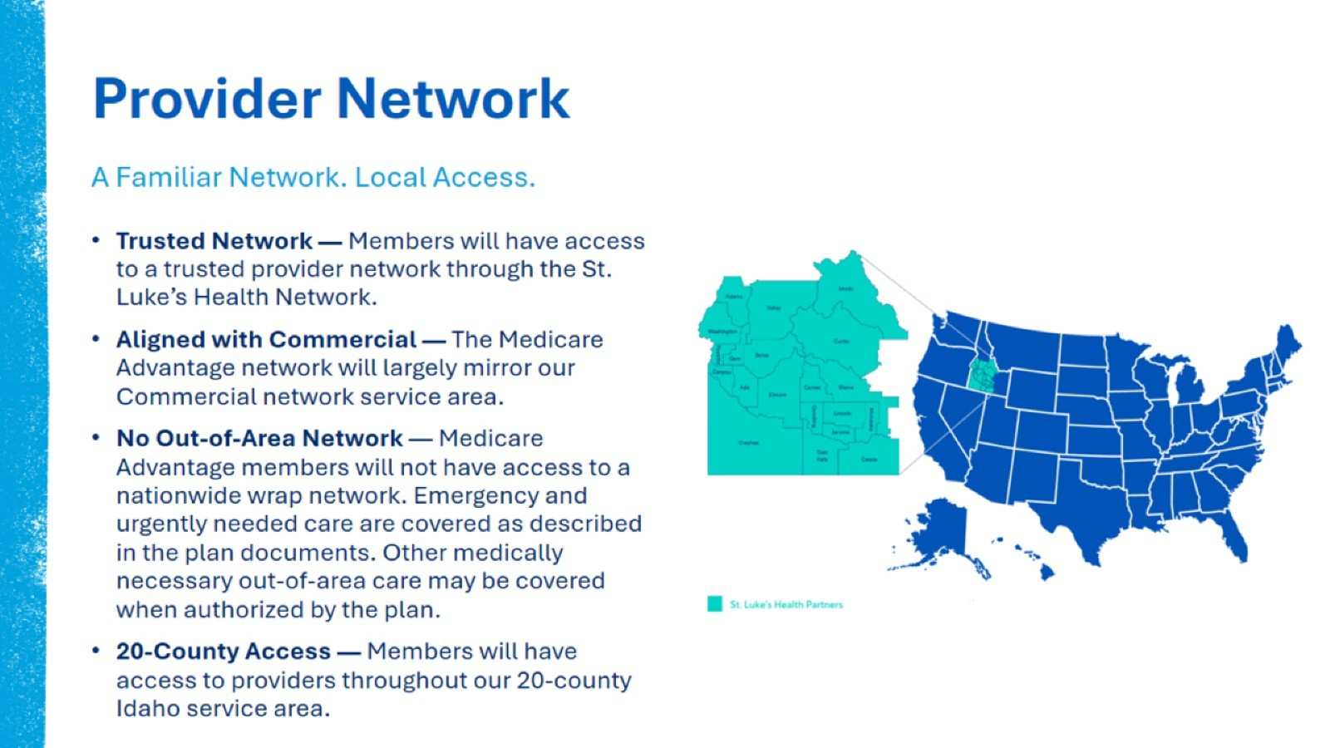
Provider Network

Slide 5

St. Luke’s Advantage Plans

Slide 6
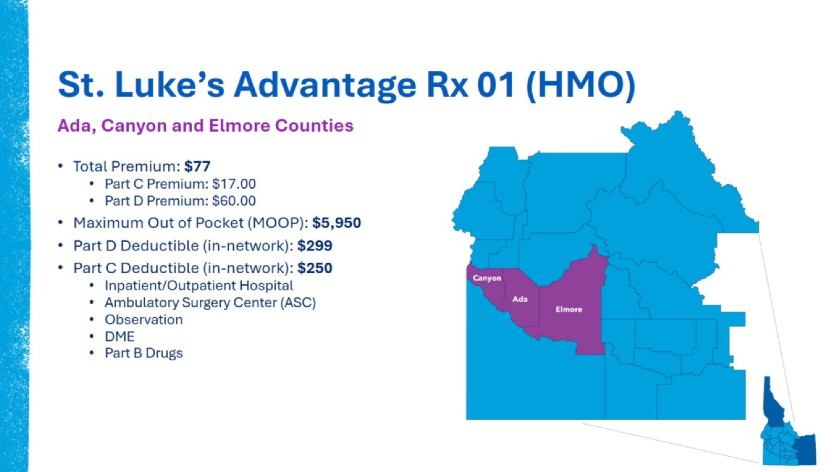
St. Luke’s Advantage Rx 01 (HMO)

Slide 7
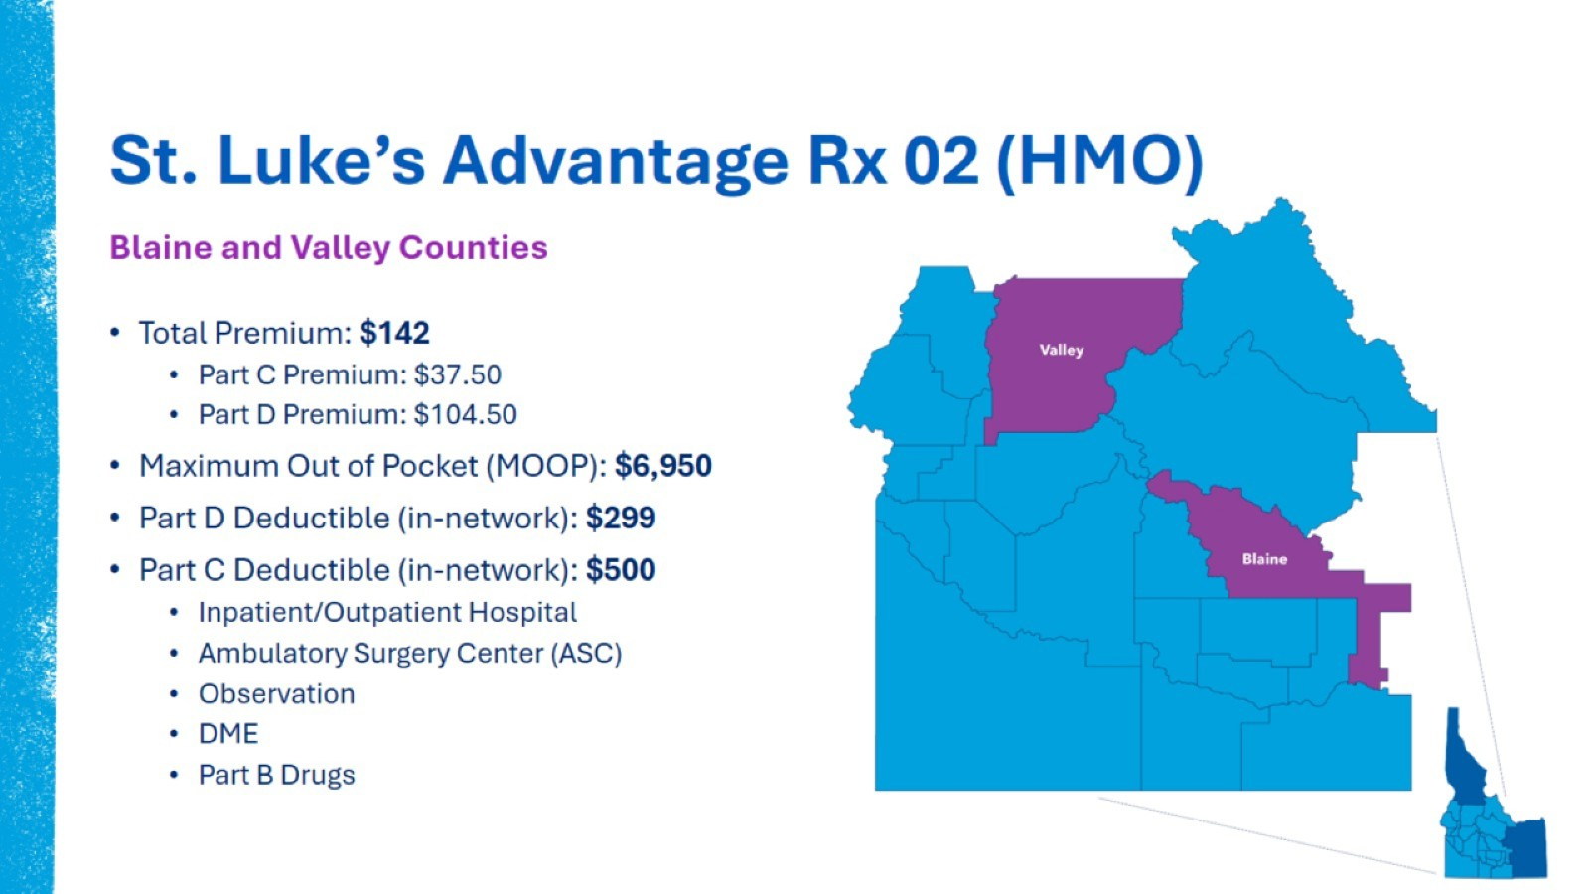
St. Luke’s Advantage Rx 02 (HMO)

Slide 8
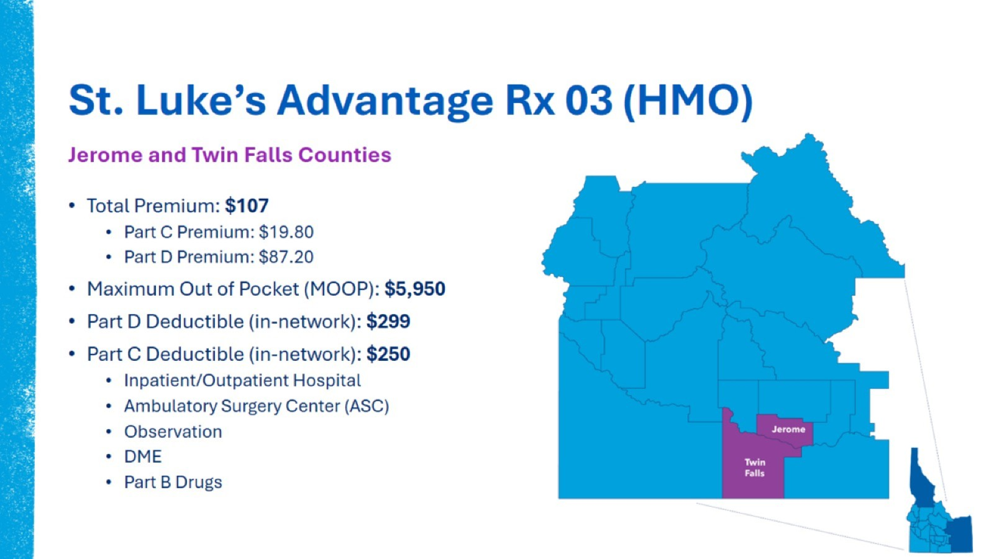
St. Luke’s Advantage Rx 03 (HMO)

Slide 9
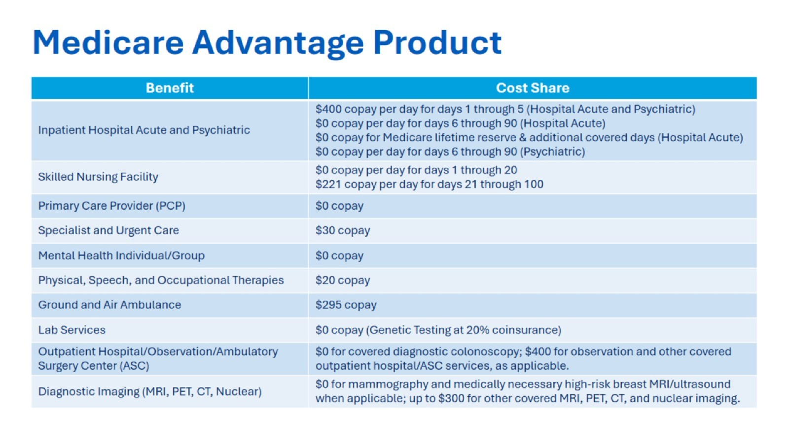
Medicare Advantage Product

Slide 10
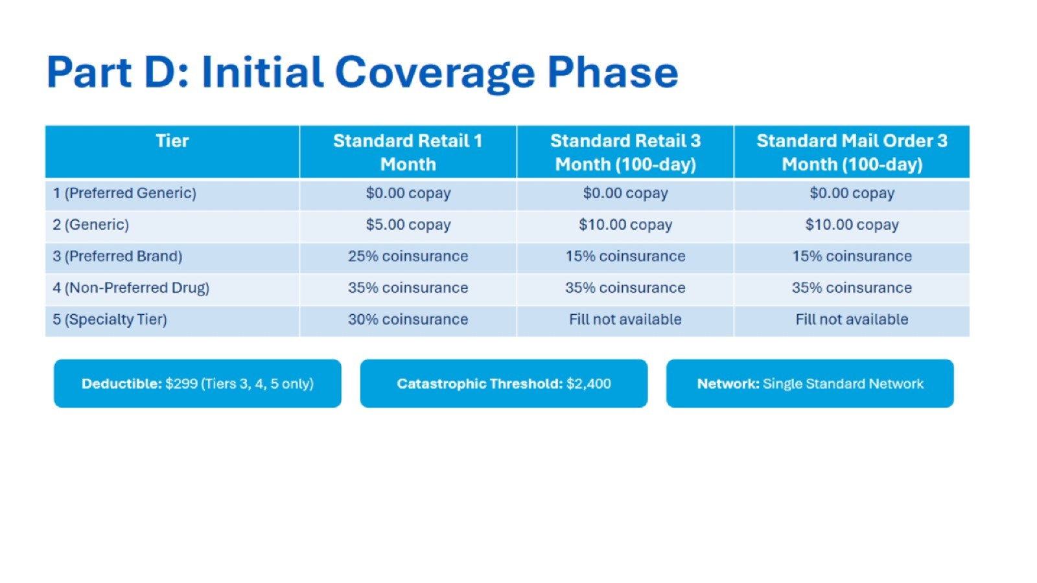
Part D: Initial Coverage Phase

Slide 11
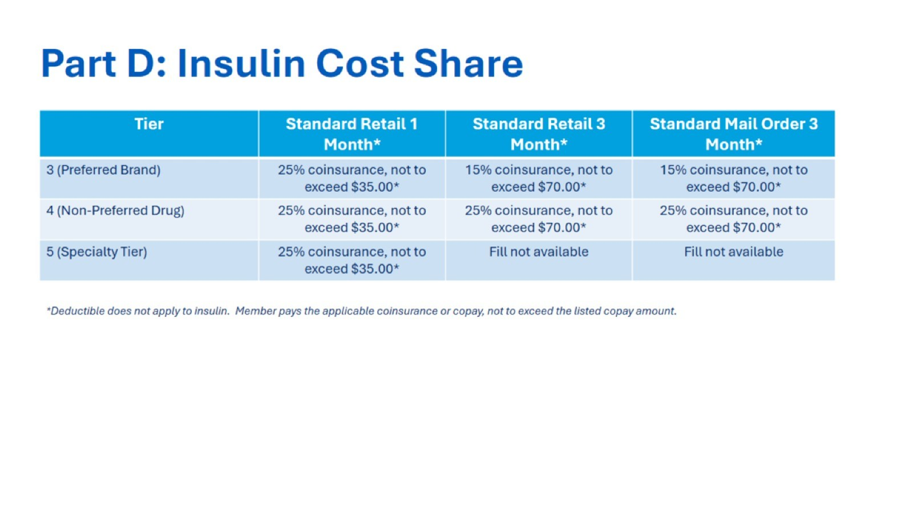
Part D: Insulin Cost Share

Slide 12
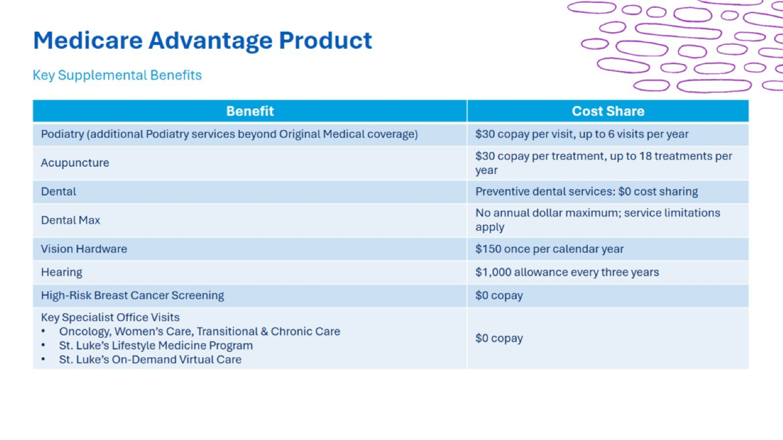
Medicare Advantage Product

Slide 13

Dental Benefits

Slide 14

St. Luke’s Lifestyle Medicine

Slide 15
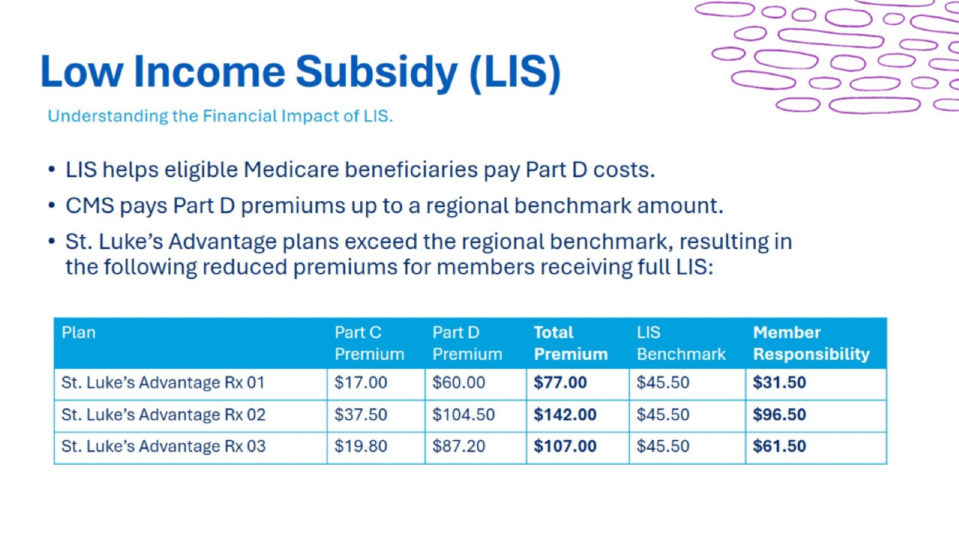
Low Income Subsidy (LIS)

Slide 16
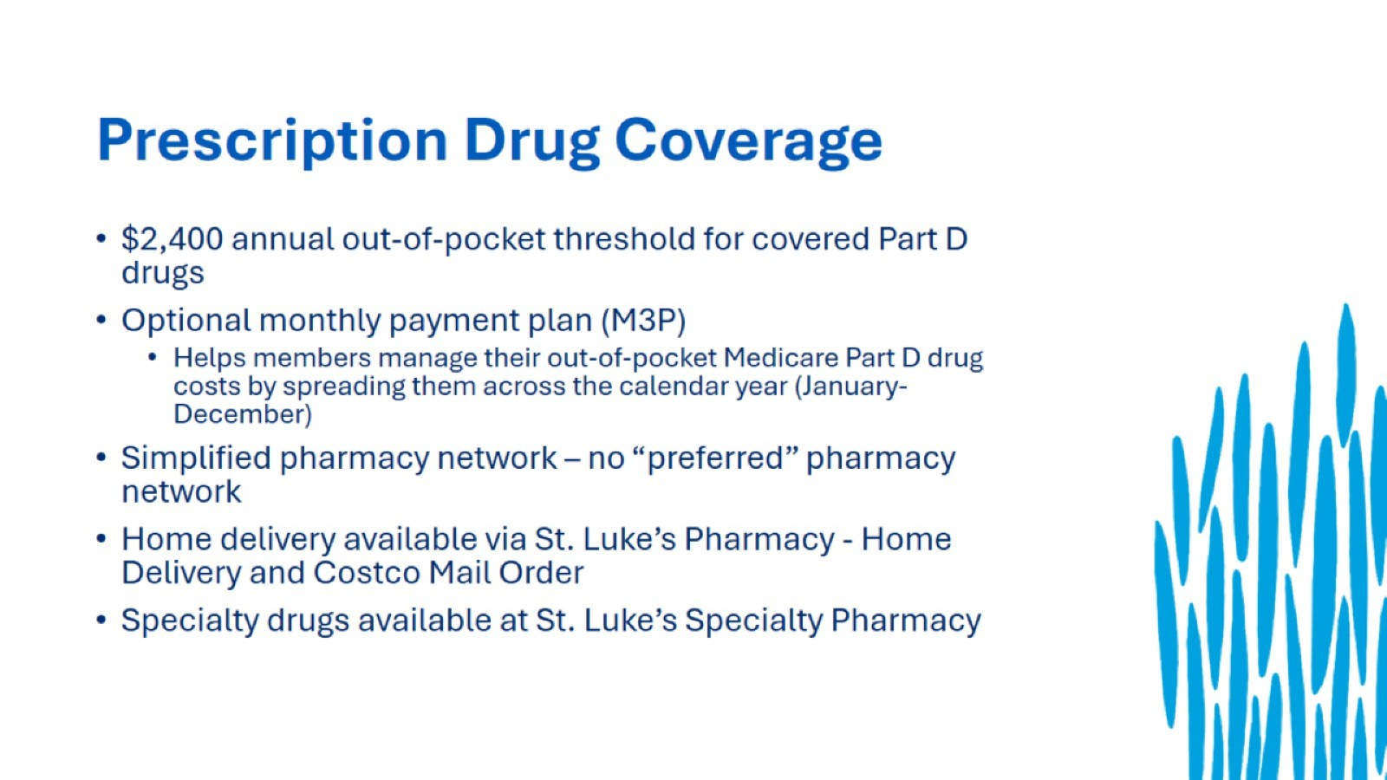
Prescription Drug Coverage

Slide 17
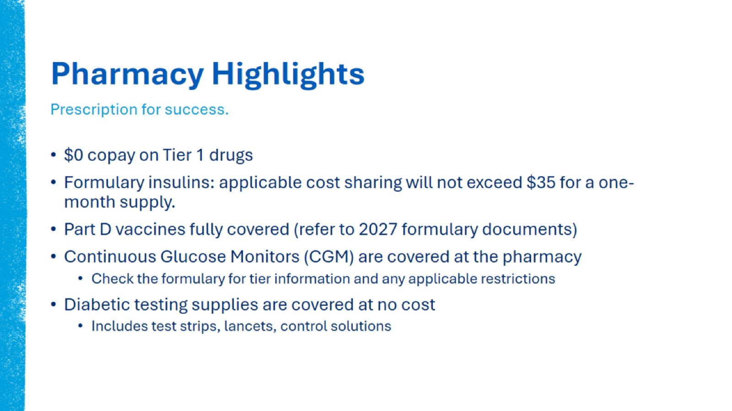
Pharmacy Highlights

Slide 18

Drug Tiers

Slide 19
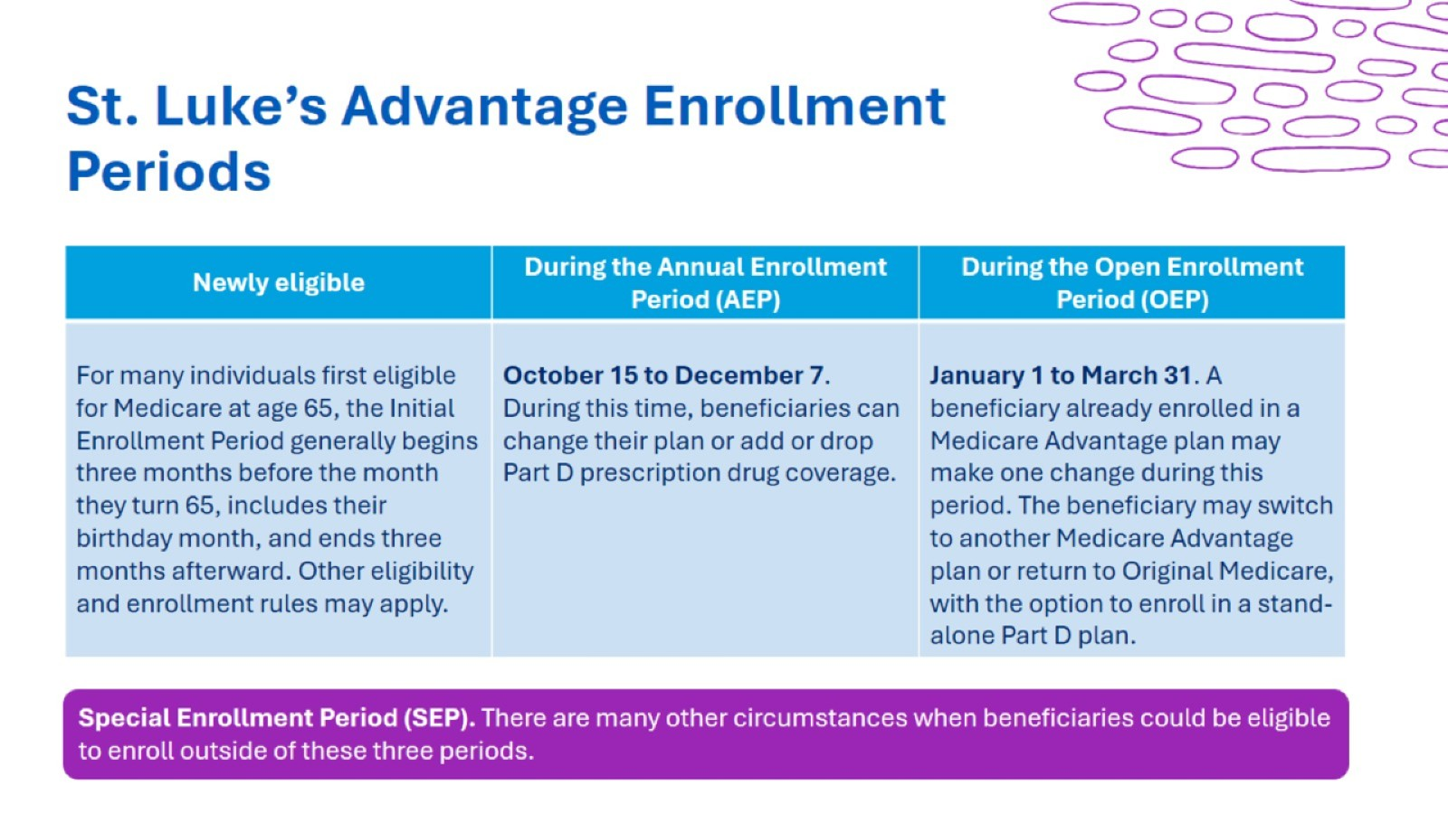
St. Luke’s Advantage Enrollment Periods

Slide 20
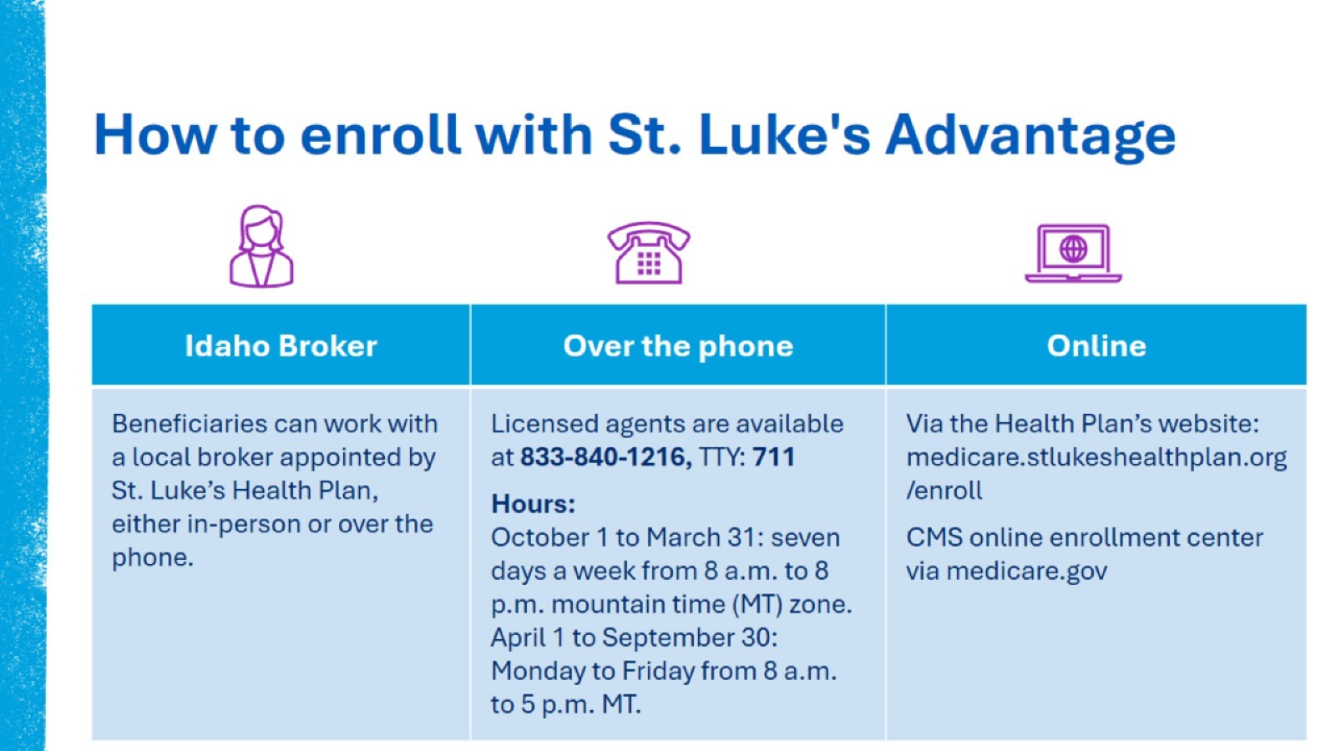
How to enroll with St. Luke's Advantage

Slide 21

Enrollment Application

Slide 22

For a complete description of what our plan covers, see the plan’s Summary of Benefits (SB) or Evidence of Coverage (EOC) on our website: medicare.stlukeshealthplan.org. Limitations, copays, prior authorizations and restrictions may apply.
St. Luke’s Advantage Rx (HMO) is a Medicare Advantage plan with a Medicare contract and a Medicare-approved Part D sponsor. Enrollment in St. Luke’s Advantage Rx (HMO) depends on contract renewal. Benefits, premiums and cost sharing may vary by plan and county.

Slide 23

Thank you!

